Slide 1


A COMPARATIVE STUDY OF CLASSIFIERS FOR PATTERN CLASSIFICATION

Slide 2

CONTENT
01
INTRODUCTION
02
BASIC CONCEPTS/ LITERATURE REVIEW
03
PROBLEM STATEMENT / REQUIREMENT SPECIFICATIONS
04
IMPLEMENTATION
05
STANDARDS ADOPTED
06
CONCLUSION AND FUTURE SCOPE

Slide 3


INTRODUCTION
Machine learning is vital in various industries, like healthcare, finance, and social media. Selecting the best model for accurate predictions is a challenge. This project evaluates four common machine learning models: K-Nearest Neighbours (KNN), Multi-Layer Perceptron (MLP), Random Forest (RF), and Support Vector Machine (SVM). The models are tested on four datasets: Iris, Wine, Breast Cancer, and Digits.

Slide 4

BASIC CONCEPTS/ LITERATURE REVIEW
Studies have compared the performance of different classifiers on diverse datasets.
SVM performed well on benchmark datasets like Iris and Wine, while Random Forest excelled on unbalanced datasets like Breast Cancer and Pima Diabetes.
Classifier effectiveness varies based on the dataset and specific problem. Evaluating multiple classifiers on various datasets is crucial to selecting the best one.

Slide 5
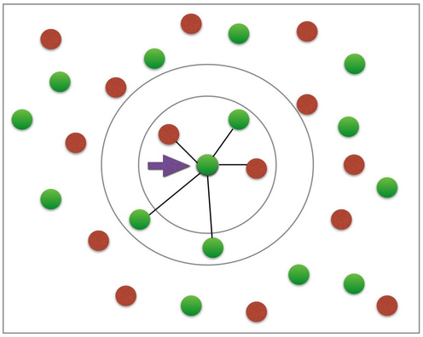
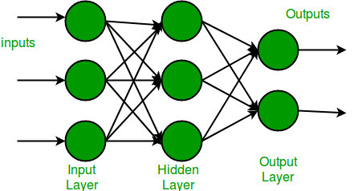
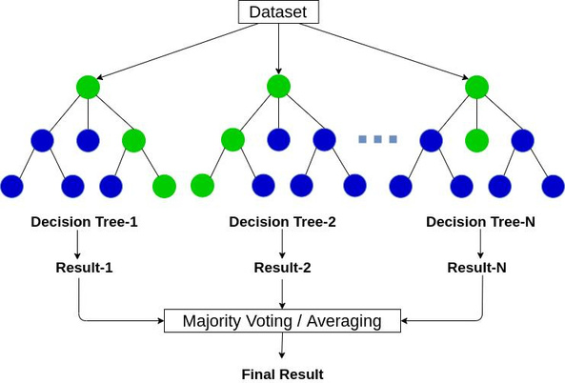
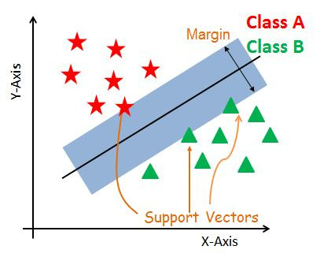
CLASSIFIERS IN MACHINE LEARNING
K-Nearest Neighbors (KNN) classifier
Multi-Layer Perceptron (MLP) classifier
Random Forest classifier
Support Vector Machines (SVM) classifier

Slide 6
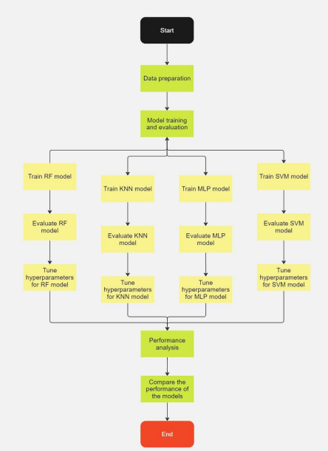
PROBLEM STATEMENT / REQUIREMENT SPECIFICATIONS
Project purpose
Compare accuracy, precision, recall, and F1-score of machine learning classifiers on diverse datasets (Iris, Wine, Breast Cancer, Digits) to identify the most suitable classifier for specific situations.
Design restrictions
Limited computational resources, careful hyper-parameter selection for avoiding overfitting/underfitting, consideration of dataset sizes' impact on model performance.
Project Analysis
Functional requirements: data collection, preprocessing, implementing classifiers, performance evaluation, selection of best classifier, and generating reports.
Non-functional requirements: Python, Sklearn, standard computer compatibility.
Assumptions: representative datasets, accurate classification, completed preprocessing.

Slide 7
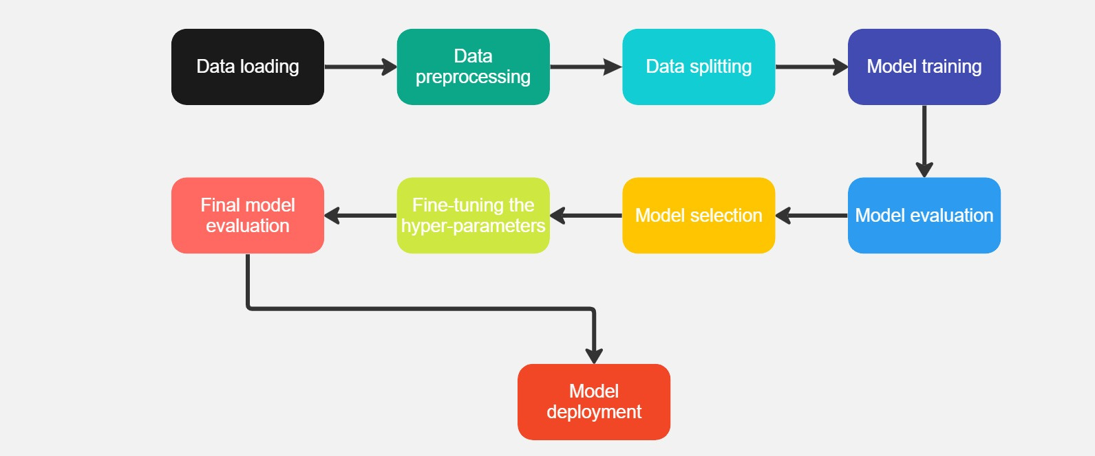
IMPLEMENTATION
Methodology/Proposal

Slide 8
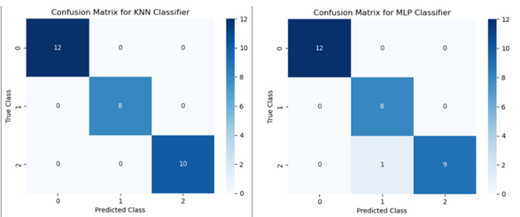
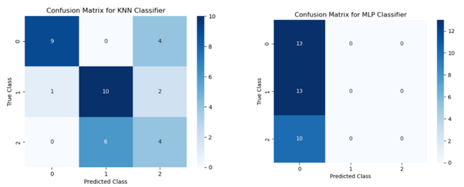
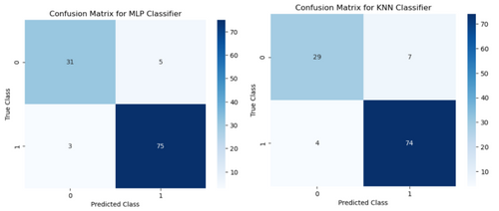
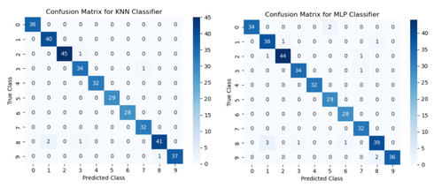
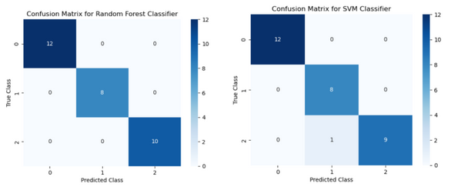
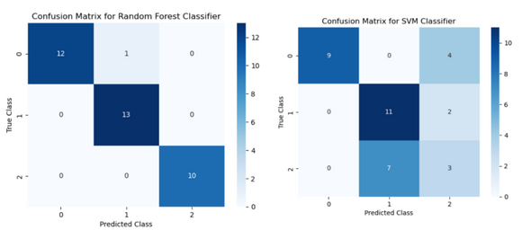
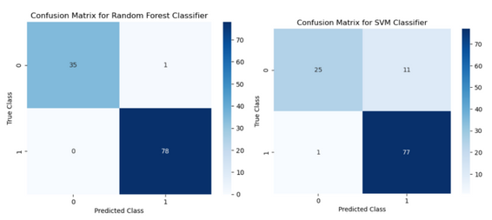
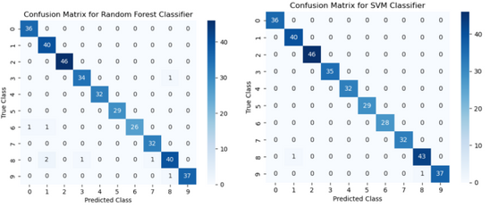
IMPLEMENTATION
Testing/Verification Plan
Testing/verification plan involves evaluating the performance of KNN, MLP, RF, and SVM on the testing dataset using metrics like accuracy, precision, recall, and F1 score. K-fold cross-validation, confusion matrices, and comparison of results are used to identify the best performing model for each dataset.
Result Analysis/Screenshots
Outcome analysis compares evaluation measures (accuracy, precision, recall, F1 score) of each model on datasets. Visual representation through graphs/tables and screenshots validate implementation, providing insights into model performance, strengths, and limitations.

Slide 9
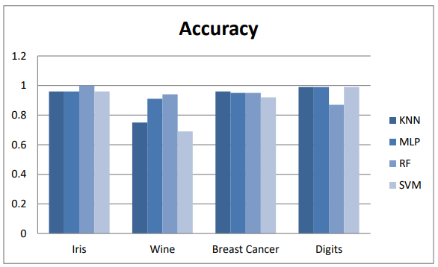
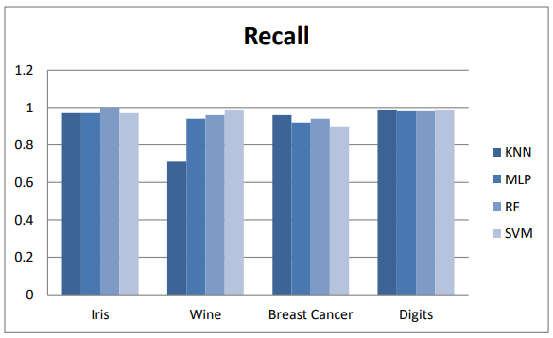
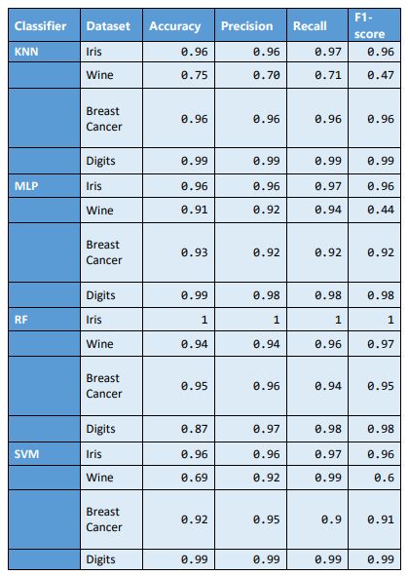
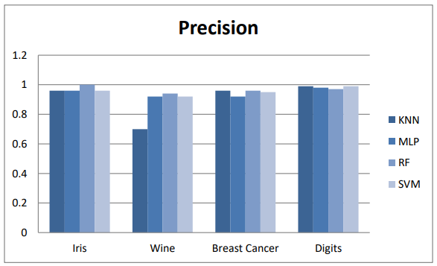
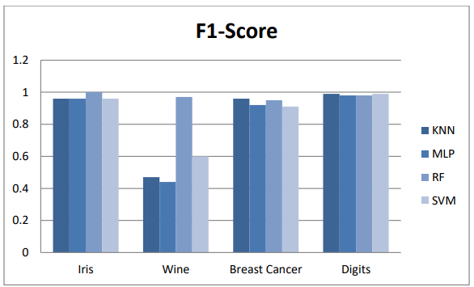
IMPLEMENTATION
Comparative-Table

Slide 10


IMPLEMENTATION
Quality Assurance
Datasets used in the research are reputable and pretreated to ensure their quality and suitability for machine learning. Models undergo testing with diverse assessment indicators to obtain a comprehensive performance overview.
The well-documented code facilitates comprehension, usage, and future modifications. Comments clarify each step's purpose, enhancing code understandability and enabling ease of modification.
The implementation undergoes rigorous testing to ensure proper functionality with diverse datasets and parameters. Edge cases are considered to handle various scenarios without errors. Best practices in software engineering and machine learning are followed to achieve a high-quality implementation.

Slide 11
STANDARDS ADOPTED
Design Standards
Coding Standards
Design standards ensure high-quality and maintainable systems.
Criteria include hardware/software limitations, compatibility, performance, scalability, and security.
Design patterns and best practices enhance system structure and maintainability.
Following guidelines leads to organized development and quality products.
Industry-standard coding practices and principles were utilized for code maintainability, readability, and modularity.
Proper naming conventions were followed for variables, functions, and classes to enhance code readability and understandability.
Comments were added throughout the code to explain its purpose, usage, and limitations.
These practices facilitate code comprehension and future maintenance.

Slide 12

STANDARDS ADOPTED
Testing Standards
Testing standards ensure project quality and reliability.
Various testing approaches, such as unit testing, integration testing, and system testing, are employed.
Unit testing verifies individual code components, integration testing examines component interaction, and system testing ensures overall system compliance.
Peer reviews identify faults and enhance code quality.
Performance monitoring and comparison evaluate the effectiveness of machine learning algorithms.
Testing standards ensure accurate, functional, and robust code that meets project specifications.

Slide 13

CONCLUSION
The study aims to evaluate and compare the performance of four machine learning models (KNN, MLP, RF, and SVM) on three datasets (Iris, Wine, and Breast Cancer).
Preprocessing the data, training the models on training sets, and evaluating their performance using accuracy, precision, recall, and F1 score were included in the project.
Results indicate that the Random Forest model outperformed the other models on all three datasets.
SVM and MLP performed relatively well, while KNN had the lowest performance among the models.

Slide 14

FUTURE SCOPE
The project has potential for further development, including experimenting with additional machine learning algorithms and assessing their performance on the current datasets.
Expansion can involve incorporating new datasets and examining the impact of feature engineering and hyperparameter optimization on model performance.
Enhancing user-friendliness and accessibility can be achieved by integrating a web-based user interface with the project.

Slide 15
THANK YOU

